Slide 1


Last One Standing
Copyright @ 2017, GameCloud
By:Karmen and Stanley

Slide 2
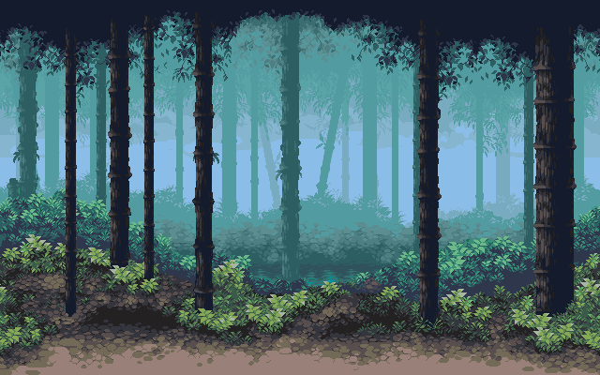




Slide 4


Slide 5
GAME OVER
Continue?
[Yes]
[No]

